Slide 1

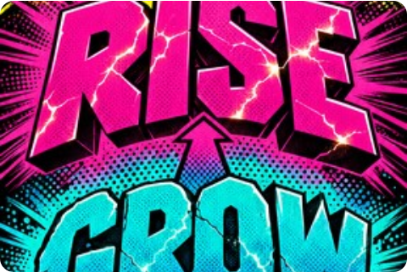
COMICCRAFT AI STUDIO
Production Documentation
MULTIMEDIA AI WORKFLOW
Arun & The Time Travel Phone
End-to-end production documentation for an 8-panel AI comic story generated with Gemini, Grok Imagine, Voice TTS, and FFmpeg.

Slide 2


PROJECT ARCHITECTURE
Production Deliverables & Agenda
8-Panel Comic Story
Gemini Prompt System
Voice Narration
Automated Video
Structured shonen anime narrative with complete visual prompts.
Custom prompt engineering for consistent character & panel styling.
Multilingual TTS narration synchronized across all story panels.
FFmpeg and ImageMagick automated 1080p video rendering.
Full Technical Stack
Python • Bash • FFmpeg • ImageMagick • Gemini Pro • Grok Imagine

Slide 3
WORKFLOW PIPELINE
System Architecture
STEP 01
STEP 02
STEP 03
STEP 04
Story Outline
Gemini LLM
Image & Voice
FFmpeg Video
8-panel time-travel synopsis & concept description.
Structured JSON script breakdown & visual prompt generation.
Anime art panels & TTS Leo narrator audio generation.
Title card overlays & audio multiplexed 1080p MP4 export.
Fully Automated Pipeline: Transforms raw text concepts into professional multi-page slides, audio narration, and video broadcasts in under 3 minutes.

Slide 4

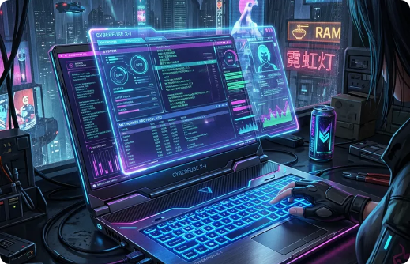


STORY CHAPTER I
The Discovery & The Call
PANEL 01
The Discovery
PANEL 02
The Call
Arun finds a strange old phone in his room that he has never seen before, glowing with mysterious ambient energy.
The phone suddenly rings in the dark. The glowing cyan screen displays an impossible caller ID: "Future Calling".

Slide 5
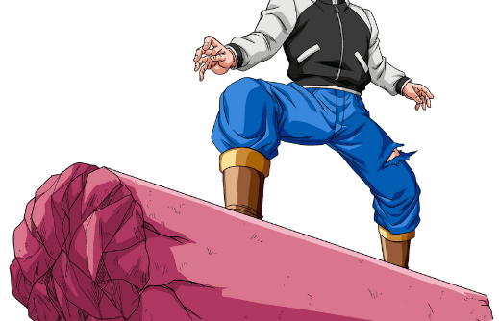
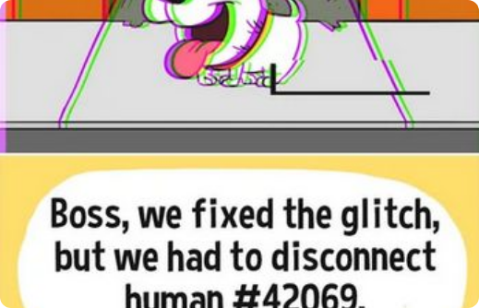
STORY CHAPTER II
The Future Voice & The First Change
PANEL 03
The Future Voice
PANEL 04
The First Change
Arun answers nervously. His future self speaks from the speaker, warning him about critical upcoming events.
Using instructions from the phone, Arun alters a small present decision and watches his immediate reality glitch and shift.

Slide 6
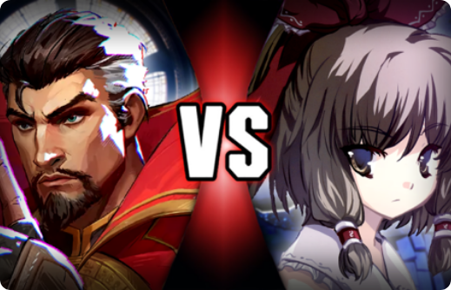

STORY CHAPTER III
The Problem & The Realization
PANEL 05
The Problem
PANEL 06
The Realization
A dangerous ripple effect triggers temporal paradoxes. Small timeline changes erupt into unpredicted chaos.
Arun understands that manipulating time carries grave risks and must be executed with extreme foresight.

Slide 7
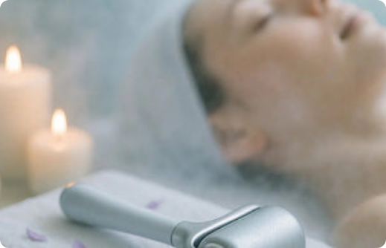
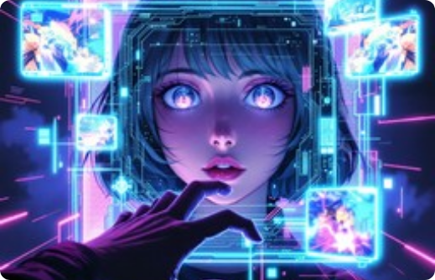
STORY RESOLUTION
Fixing Time & The Mystery Continues
PANEL 07
Fixing Time
PANEL 08
Mystery Continues
He uses the device strategically to mend broken timelines and restore cosmic balance to the present.
The phone vanishes into digital particles, leaving Arun wondering if the future will call once again.

Slide 8
PROMPT ENGINEERING
Gemini System Prompt Design
// Gemini System Prompt Template
You are ComicCraft, an expert AI comic creator.
1. Expand story outline into exactly 8 detailed panels.
2. Output JSON format containing:
- panel_title
- visual_description (lighting, pose, angle)
- dialogue_caption
3. Maintain character consistency for Arun across all 8 panels.
4. Art style: Shonen anime, glowing cyan accents, dramatic lighting.
Strict Structural Constraint
Enforces 8 distinct, well-balanced story panels per generated episode.
Art Style Locking
Applies signature anime linework, cyan time-travel glyphs, and high contrast.
JSON Interoperability
Output feeds directly into image prompt generators and video automated engines.

Slide 9
AUDIO SYNTHESIS
Voice Narration Pipeline
101s
Leo
128k
Audio Duration
Voice Model
AAC Bitrate
Synchronized perfectly with 10 video slides.
Energetic male narrative voice tailored for adventure.
Crystal clear high-fidelity audio stream output.
Timeline Allocation Rules
Title Intro Card
5 Seconds
Panels 1 through 8 (12s each)
96 Seconds Total
Outro End Card
5 Seconds

Slide 10
VIDEO RENDERING
ImageMagick & FFmpeg Processing
# 1. ImageMagick Panel Card Generation
convert -size 1920x1080 xc:'#0a1628' \
-font DejaVuSans-Bold -pointsize 80 -fill '#00FFFF' -annotate +0+100 "Panel 1: Discovery" \
-pointsize 36 -fill white -annotate +0+250 "Arun finds a mysterious phone..." panel1.png
# 2. FFmpeg Video Stitching & Audio Mapping
ffmpeg -y -loop 1 -t 5 -i title.png -loop 1 -t 12 -i panel1.png ... -i narration.mp3 \
-filter_complex "[0:v][1:v]...concat=n=10:v=1:a=0,format=yuv420p[v]" \
-c:v libx264 -preset ultrafast -c:a aac -shortest output.mp4
Codec: libx264
Pixel Format: yuv420p
Web Optimization
High compatibility video streaming format.
Standard across web, mobile, and desktop players.
Faststart flag enabled for instant browser playback.

Slide 11



TECH STACK
Full Production Stack
AI Core
Image Gen
Video Engine
Slide Deck
Google Gemini 1.5 Pro & Grok Conversational Models
Grok Imagine & Custom Anime Prompt Drivers
FFmpeg CLI, ImageMagick & Python Pillow
PptxGenJS Node.js & Custom HTML Deck Engines
Fully reproducible open-source workflow execution scripts included in project repository.

Slide 12

Production Complete
The complete Time Travel Phone multimedia package — including audio narration, MP4 video, and PowerPoint presentation — is generated and ready for distribution.
Questions & Discussion
ComicCraft AI Story Creator

Slide 13






Image Sources
https://images.stockcake.com/public/8/b/b/8bb05ada-8bb6-4f89-aea0-989a52bdfc17_medium/motivational-pop-typography-stockcake.jpg
Source: stockcake.com
https://media.easy-peasy.ai/172597de-9259-42e6-ba2d-069ad50a7ecf/c8c32d6b-4fde-4fe5-9e71-67ea405f5a26_medium.webp
Source: easy-peasy.ai
https://images.stockcake.com/public/e/b/a/eba1139e-f7f9-42f8-a4b9-b386b8bfa45e_medium/digital-neon-dreams-stockcake.jpg
Source: stockcake.com
https://thecodex.wiki/images/thumb/c/c4/DBXV2_Pre-Order_Bonus_DLC_Future_Warrior_%28promotional_Male_Saiyan%29_Vehicle_Capsule_No._881_%28Tao_Pai_Pai%27s_Pillar%29.png/848px-DBXV2_Pre-Order_Bonus_DLC_Future_Warrior_%28promotional_Male_Saiyan%29_Vehicle_Capsule_No._881_%28Tao_Pai_Pai%27s_Pillar%29.png
Source: thecodex.wiki
https://static.tvtropes.org/pmwiki/pub/images/rsz_matrixglitch.png
Source: tvtropes.org
https://g1-team.com/wp-content/uploads/2026/04/picture1-3.png?w=507
Source: g1-team.com

Slide 14


Image Sources
https://purespadirect.com/cdn/shop/articles/how-to-use-cryo-facial-roller_20250811012000_20250811-ai.jpg?crop=center&height=195&v=1780892998&width=375
Source: purespadirect.com
https://images.stockcake.com/public/5/7/a/57a41e4a-4322-4c65-a1dc-de5c9402f831_medium/digital-dreams-awaken-stockcake.jpg
Source: stockcake.com

